Slide 1
Faraday
“To achieve success, consistency must come first.”
Confidential & Proprietary; Copyright © 2011, Insert you company name here .

Slide 2

Problem
It is known that almost 80% traders lose their money in the stock market
Novices try gaining
learning experience
by putting real money
on the line

Slide 3
Solution
Learning stocks has become way easier. Plus it’s way more fun with the competition.
The product is meant to be beginner-friendly and as a learning product.
Students want competition and a peer group while learning anything. The contests and discussions in Faraday achieve

Slide 4
Our Solution
Stock Simulator
Virtual Money
Real Time Data
Real Time but Virtual Portfolio
Better practical experience than just reading books about investing and trading
Risk free experience compared to real market
Leaderboard for healthy competition alongside learning and forum for discussion

Slide 5
Customer Needs
This platform is open to all, but currently we allow for virtual trading only in Indian exchanges
A lot of people including me were looking for such a virtual platform for trading. There are a lot of backtesting platforms for programmers but any hardly allow for forward testing

Slide 6
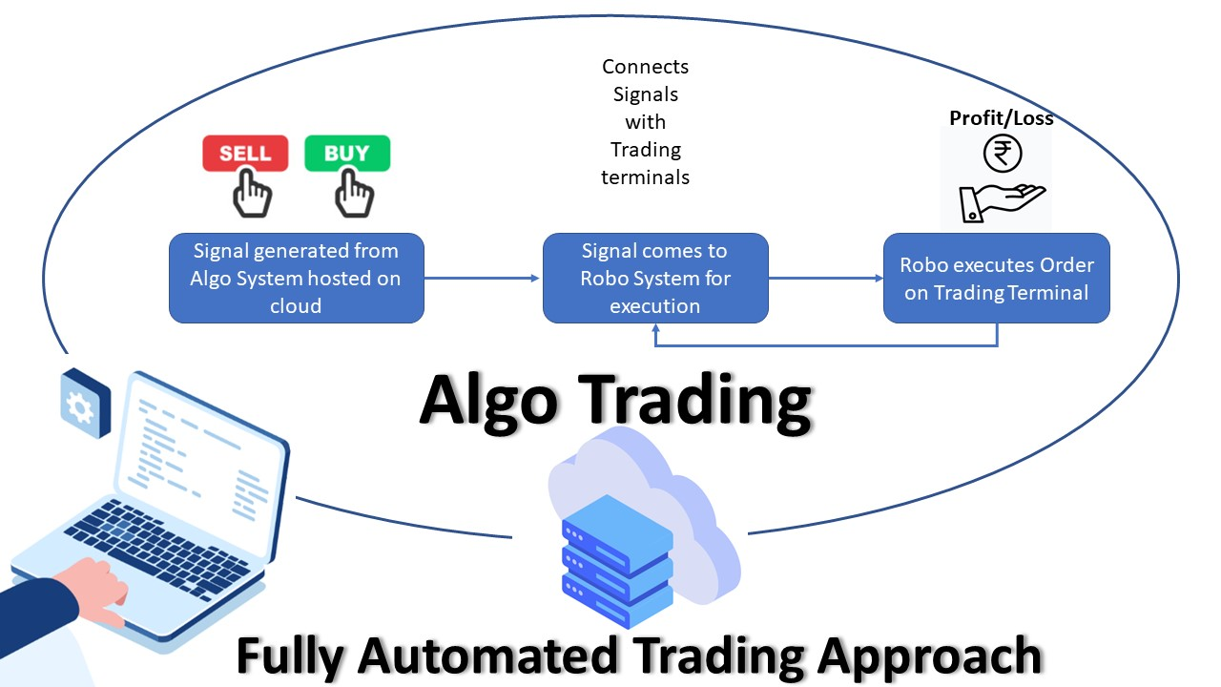
Market Potential
During the pandemic, we experienced a surge in the number of market participants
This is expected to only rise
In particular Algorithmic Trading has started to take over

Slide 7
Business Model
API Access can be charged at low rates ahead in the future
We can allow for financial firms to conduct hiring contests to recruit the best traders
We can partner with media companies to display their articles on our website
The amount of investment required is low, but the profits can be huge
First target would be to sell it to college mates, and conduct algorithmic trading sessions to get them started. We are mainly relying on word of mouth for now

Slide 8

Competition
Alpaca - but mainly for US Stocks

Slide 9
Team
Founders & Laying the Road Map Ahead
We created this to solve the problem that we faced ourselves, so we would be able to better identify customers
This is a new domain to us too, and hence we plan to learn more about it on the go
We want to solidify our interface to the user and scale this project to be able to handle multiple user queries

Slide 10
Contact
Alapan Chaudhuri : ac.ala.arya@gmail.com
Shreyas Pradhan : shpradhan@gmail.com
Zeeshan Ahmed : zeeshan060801@gmail.com
Shivansh Subramanian: subramanian.shivansh@gmail.com

